Slide 1
System REQUIREMENTS
CT026-3-1-Systems Analysis and Design

Slide 2
Topic Learning Outcomes
At the end of this topic, you should be able to:
1. List FIVE (5) questions which could be used in an interview to determine user
requirements
2. List and describe the SEVEN (7) interview steps
3. List SIX (6) fact-finding techniques

Slide 3
Contents & Structure
Requirement Gathering Techniques
Types of Requirements

Slide 4
Key terms you must be able to use
If you have mastered this topic, you should be able to use the following terms correctly in your assignments and exams:
Fact-finding
Interview
Sampling
Questionnaire
Observation

Slide 5
Recap From Last Lesson
Explain FOUR (4) types of feasibility study?

Slide 6

Requirements Analysis
Also known as Fact-Finding Process, Requirement Elicitation.
Purpose: To find or gather requirements for a system to be developed.
“once stated, it has to be met”
Slide 6 (of

Slide 7
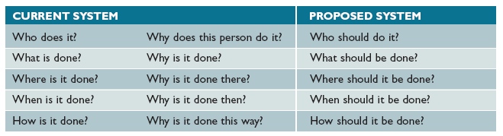
Questions asked in search of facts are :
WHO
WHAT
WHERE
WHEN
HOW
WHY

Slide 8



Fact-finding techniques
Interview
Document review
Observation
Sampling
Research
Surveys and questionnaires

Slide 9
Interview
planned meeting during which you can obtain information from another person.
Skills are required to plan, conduct and document interviews.
An information-gathering which is a directed conversation with a specific-purpose that uses a question and answer format.
Most important is seek the opinion of the person you are interviewing as opinion are more important than facts

Slide 10
Interview
Step 1: Determine the people to interview
Select the right people and ask the right questions
Don’t rely on just an organisation chart
Decide on group and/or individual interviews
Step 2. Establish objectives for the interview
Determine the areas to be discussed
List the facts you need to gather
Upper management provides the big picture
Users can give you specific details

Slide 11
Interview
Step 3. Develop interview questions
Decide what to ask and how to phrase the question
The same question to different people - for comparison
Open ended questions encourage spontaneous and unstructured responses
Close ended questions limit the response - used to verify facts
Range of response questions limit the response – uses a scale
On a scale of 1 to 10, with 1 the lowest and 10 the highest, how effective was your training?

Slide 12
Interview
Step 4. Prepare for the interview
Careful preparation is essential because an interview is an important meeting and not just a casual chat
Limit the interview to no more than one hour
Verify time, place, length, and topics via e-mail
Ask the interviewee to have samples available

Slide 13
Interview
Step 5. Conduct the interview
Develop a specific plan for the meeting
Begin by introducing yourself, describing the project, and explaining your interview objectives
Engaged listening
Allow the person enough time to think about the question
After an interview, you should summarize the session and seek a confirmation

Slide 14
Interview
Step 6. Document the interview
Note taking should be kept to a minimum
After conducting the interview, you must record the information quickly
After the interview, send memo to the interviewee expressing your appreciation
Note date, time, location, purpose of the interview, and the main points you discussed so the interviewee has a written summary and can offer additions or corrections

Slide 15
Interview
Step 7. Evaluate the interview
In addition to recording the facts obtained in an interview, try to identify any possible biases

Slide 16
Example of Interview Questions
The target interviewee is the admin staff who involved with the current system process. Each interview will take around 1 hour.
Which process takes the longest time for staff to process for you?
Do you think current system is secure?
Do you find the current system troublesome? If yes how can we improve it?

Slide 17
Interview
Unsuccessful Interviews
No matter how well you prepare for interviews, some are not successful
Misunderstanding or personality conflict could affect the interview negatively, or the interviewee might be afraid that the new system will eliminate or change his or her job
Find a way to conclude an unsuccessful meeting
Consider alternatives

Slide 18
Document Review
Aims to find out the information requirements that people have in the current system
Includes:
Review existing system documentation
Obtain copies of actual forms and documents
Review blank copies of forms
Review samples of completed forms
Review software documentation

Slide 19
Example of Document Review
The target user would be nurse of the clinic as they are the entity in charge of the hand-written documents before entering it into the system. The location to carry out sampling would be in the clinic, so questions can be asked on the spot.
1. First, the team will review all samples collected and review sorted existing document about how they run the business and understand how the clinic is operated.
2. Documents will be analyzed based on the question provided earlier and verify the reliability of the information, any information gaps or contradictory evidence will be clarified and addressed with other information gathering method where necessary.
How they keep all the record?
Any mistakes in the hand-writing record?
All patient record up-to-date?
3. Produce a summary of prioritized documents which reflects critical and relevant information that are feasible to develop a system.

Slide 20
Observation
Aim is to see what really happens, not what people say happens.
Can be open-ended or based on a schedule
Includes:
seeing how people carry out processes
Examine each form, record and report
Consider each person working with the system
Talk to people who receive current reports
Consider the Hawthorne Effect
- Productivity seemed to improve whenever workers knew they were being observed

Slide 21
Observation Example
Observation Team
The observation team positioned at the front desk will be tasked to observe the efficiency of the front desk, customers’ satisfactory towards the current system and physical space constraints of such system. In contrary, observation team positioned in the organisation will be observing the manager capability of handling staff profile and attendance marking of the current system. The observation is scheduled to run up to 6 weeks.
How do they manage all the record?
How they collect customer record?
Is there any time consuming during registration?

Slide 22
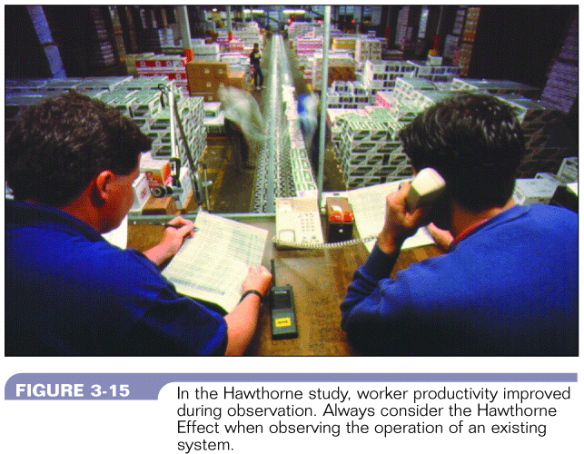
Observation – Hawthorne Effect
Figure 7-1 :Hawthorne Effect
Systems Analysis & Design (4th Edition) – Shelly Cashman Series

Slide 23
Questionnaires and Surveys
Aims to obtain the views of a large number of people in a way that can be analyzed statistically. Includes:
- postal, web-based and email questionnaires
- open-ended and closed questions
- gathering opinion as well as facts
Guidelines:
Brief, user-friendly and clear instructions
Questions in logical order
Simple wording to avoid misunderstanding
Avoid leading questions
Open-ended questions are difficult to tabulate
Limit questions raising concern / negative issues
Section for general comments
Test the questionnaires in advance

Slide 24
Questionnaires and Surveys Example
Overall, are you satisfied with the current system?
How long do you take to retrieve data from a different departments within the company?
Do you need to go to the different departments to get the different files?
[1]. Not at all [2]. Slightly satisfied [3]. Moderately
[4]. Quite satisfied [5]. Extremely satisfied
[1]. Less than 1 min [2]. 3 min to 5 min [3]. 5 to 10 min
[4]. More than 10 min
[1]. Yes [2]. No

Slide 25
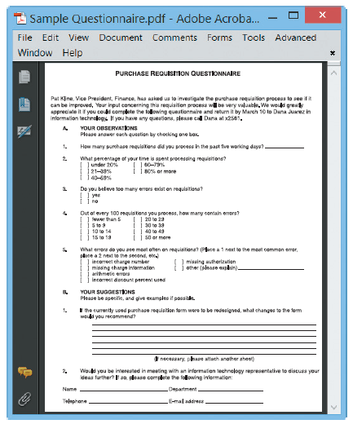
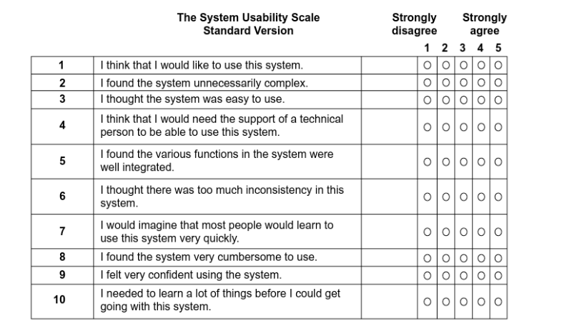
Questionnaires and Surveys
FIGURE 4-23 Online version of a sample questionnaire. Does it follow the suggested guidelines?

Slide 26
Sampling
Also known as purposive and selective sampling, purposeful sampling is a sampling technique that qualitative researchers use to recruit participants who can provide in-depth and detailed information about the phenomenon under investigation.
There are several techniques of sampling:
Systematic sample : Select every tenth customer for review
Stratified sample : Select five customers from each of four postal codes
Random sample : Any 20 customers
Main objective : to ensure representation of the overall population accurately
May considered either interviewing or questionnaires

Slide 27
Research
Journals, periodicals, books
Internet sites
Hardware and software vendors
Independent firms that provide information
Newsgroups
Professional meetings, seminars, discussions
Site visits to observe a system in use

Slide 28
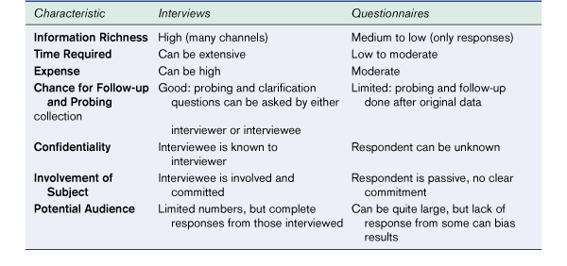
Interviews vs. Questionnaires
Figure 7.3 – Comparison of Interviews and Questionnaires
Modern Systems Analysis and Design, 3/e - Jeffrey A. Hoffer Joey F. George Joseph S. Valacich

Slide 29
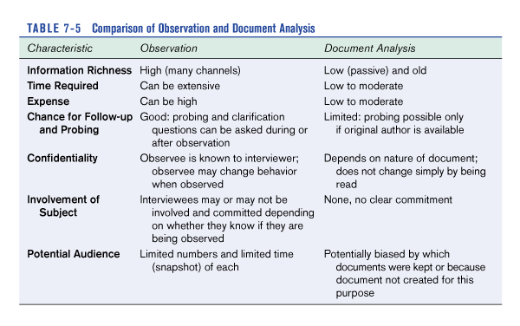
Observation vs. Document Analysis
Figure 7.4 – Comparison of Observation and Document Analysis
Modern Systems Analysis and Design, 3/e - Jeffrey A. Hoffer Joey F. George Joseph S. Valacich

Slide 30
Recording Facts
Keeping accurate records of interview, facts, ideas and research is important to successful systems development
Basic rule is to write it down
Principles to follow when recording facts are:-
Record all information as soon as you obtain it.
Use simplest recording method
Record findings properly so that it can be understood by someone else – not a member of the IS dept
Arrange documentation so that information can be brought together and coordinated

Slide 31
Software tools for recording the facts
CASE Tools (Computer-aided systems engineering) tools
Powerful programs that help systems analysts develop and maintain information systems
Provide an overall framework for systems development
Support a wide variety of design methodologies
Two CASE categories :
Upper CASE tools : support modeling process and produce a logical design of the information system
Lower CASE tools : speed the development process by generating source code based on the logical model

Slide 32
Software tools for recording the facts
Word processing
Create reports, summaries, tables and forms
Prepare standard documentation
Organize presentation with templates, bookmarks, annotations, revision control, index
Create fill-in forms to conduct surveys and questionnaires

Slide 33
Software tools for recording the facts
Spreadsheet
Track and manage numerical data or financial information
Generate graphs and charts that display the data and show possible patterns
Use statistical functions to tabulate and analyze questionnaire data

Slide 34
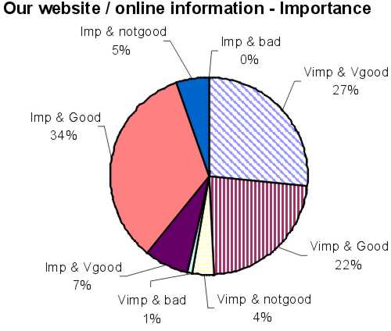
Software tools for recording the facts
Spreadsheets
Figure 7-5 : Sample Pie Chart
Retrieved from : http://www.lboro.ac.uk/computing/info/images/web-imp.jpg
Slide 17 (of 24)

Slide 35
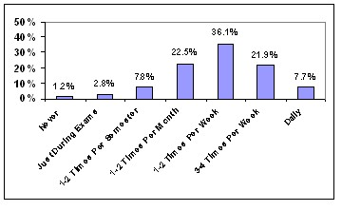
Software tools for recording the facts
Spreadsheets
Figure 7-6 : Sample Histogram
Retrieved from : http://www.library.tufts.edu/tisch/bibliotech/btc34.htm

Slide 36
Software tools for recording the facts
Database
To manage information about events, observations and samples
To manage the details of a complex project, create queries to retrieve specific information, and generate reports
Presentation graphics
For organizing and developing formal presentations
To create organization charts which can be included in written reports and management presentations

Slide 37
Software tools for recording the facts
Personal Information Managers
To keep track of meetings, interviews, appointments, and deadlines that are weeks or months in the future
To manage tasks and provide a personal calendar and a To-Do list, with priorities and the capability to check off completed items

Slide 38
Types of Requirement
Functional
Non-functional
Architectural
Business
System/Technical
User
Security
User Interface

Slide 39
Functional Requirements
Describe what a system must do
Usually detailed statements of capabilities, behavior, and information that the solution will need.
Include(s):
Processes
Interfaces with users and other systems
What the system must hold data about
Example:
The system shall allow the user to log out.
The system shall allow the user to register.

Slide 40
Non-Functional Requirements
Specifies criteria that can be used to judge the operation of a system, rather than specific behaviors.
Often considers the quality aspects of the new system, such as testability, maintainability, extensibility and scalability
Include(s): (not limited to these)
Response times
Security considerations
Example:
Security: The system must be able to log out the user automatically in case of idle for more than 20 seconds.
Reliability :The system shall not allow registration for the same user, use identification number as key
Platform compatibility: The system can be run in different platforms.

Slide 41
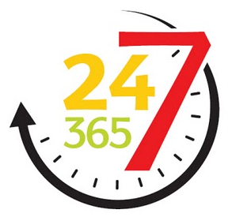
Availability % | Downtime per year | Downtime per month
90% ("one nine") | 36.5 days | 72 hours
95% | 18.25 days | 36 hours
97% | 10.96 days | 21.6 hours
98% | 7.30 days | 14.4 hours
99% ("two nines") | 3.65 days | 7.20 hours
99.5% | 1.83 days | 3.60 hours
99.8% | 17.52 hours | 86.23 minutes
99.9% ("three nines") | 8.76 hours | 43.8 minutes
99.95% | 4.38 hours | 21.56 minutes
99.99% ("four nines") | 52.56 minutes | 4.38 minutes
99.995% | 26.28 minutes | 2.16 minutes
99.999% ("five nines") | 5.26 minutes | 25.9 seconds
99.9999% ("six nines") | 31.5 seconds | 2.59 seconds
99.99999% ("seven nines") | 3.15 seconds | 262.97 milliseconds
99.999999% ("eight nines") | 315.569 milliseconds | 26.297 milliseconds
99.9999999% ("nine nines") | 31.5569 milliseconds | 2.6297 milliseconds

Slide 42
Architectural Requirements
explain what has to be done by identifying the necessary systems structure and systems behavior
Business Requirements
High-level statements of the goals, objectives, or needs of an organization.
System/Technical Requirements
The infrastructure that the new system needs to run on.
Minimum Hardware requirements such as server, storage space, processing power, etc.
Software needs such as OS, applications, plug-ins, etc.
Networking needs such as bandwidth, protocols etc.

Slide 43
User Requirements
Mid-level statements of the needs of a particular stakeholder or group of stakeholders.
They usually describe how someone wants to interact with the intended solution.
Security Requirements
The types and levels of security that the new system needs.
Authorization levels, Encryptions, etc.
User Interface Requirements
Specific design criteria for the user interface.
Color, language, etc.

Slide 44
Deliverable: System Requirement Specifications (SRS)
Structured collection of information that contains the finalized requirements of a system
Contains finalized requirement for System Design
Popular Requirement groups;
Functional Requirements
Non-Functional Requirements
Architecture Requirements
Business Requirements
System / Technical Requirements
User / Stakeholders Requirements
Security Requirements
User Interface Requirements, etc

Slide 45
Summary
Systems Analysis
Fact-finding techniques
Document review
Observation
Surveys and questionnaires
Sampling
Research
Recording facts
Principles to follow
Software tools used

Slide 46
Question and Answer Session
Q & A

Slide 47
What To Expect Next Week
In Class
Preparation for Class
System Analysis – Logical Modelling
Download the slide and study for the next chapter.

